Slide 1
YouTube Video Downloader
A Custom Solution for Offline Video Access

Slide 2
Introduction
•Downloading videos from YouTube can be a tedious manual process
•This program automates the process of downloading YouTube videos and playlists
•It allows choosing the video quality, formats and additional options like subtitles, thumbnails, audio etc.
•The program uses the yt_dlp library to extract info about videos/playlist and also to download them.
•PySimpleGUI is used to develop the graphical user interface (GUI)
•The GUI provides useful feedback during the download process like progress, speed and estimated time remaining.

Slide 3
Motivation
•Online YouTube downloaders have limitations and lack customizability
•You have no control over format, quality, features like subtitles, audio, etc
This motivated me to build a custom YouTube video downloader program with:
- Control over format, quality and extra features
- Useful feedback and progress reporting during download
- Ability to bulk download entire playlists
- Error handling for network issues and invalid URLs

Slide 4
Technologies used
• Python
• Core libraries:
• yt-dlp
• PySimpleGui
• ffmpeg

Slide 5
Features and Functionalities
•Inputs either a single YouTube video URL, a YouTube playlist URL, or a YouTube channel URL
•Allows selecting the video quality from a range of options (144p, 240p, 360p etc)
•Provides options to download:
- Audio only
- Both video and audio
•Option to download English subtitles if available for the video
•Downloads the thumbnail image for the video
•Allows downloading comments related to the video

Slide 6
Features and Functionalities cont.
•For playlist URLs, additional features include:
- Selecting range of videos to download from the playlist
- Automatically numbering downloaded videos
- Option to put each downloaded video in its own folder
•Provides useful feedback during the download process:
- Percentage completed
- Current download speed
- Estimated time remaining

Slide 7
User Interface and Design
•The user interface is designed using PySimpleGUI, a Python GUI library
•The layout uses frames, columns, images and other widgets for an organized, appealing design

Slide 8
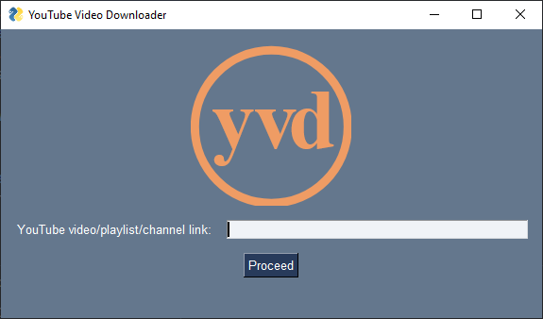
•The initial screen has a focused input field for the YouTube URL

Slide 9
•The progress screen displays relevant video information in an easy-to-read format
•Quality and format options are provided in a drop-down combo box
•Additional download features are presented in checkboxes for easy selection
•Useful feedback is displayed during the download process:
Percentage complete bar
Current download speed
Estimated time remaining
•Error handling is done through pop-up windows to clearly notify the user
• The interface allows the user to continue downloading new URLs after completion

Slide 10
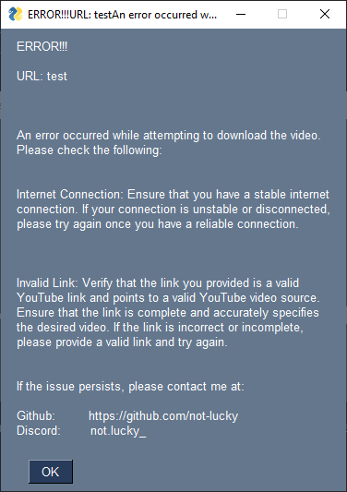

Slide 11
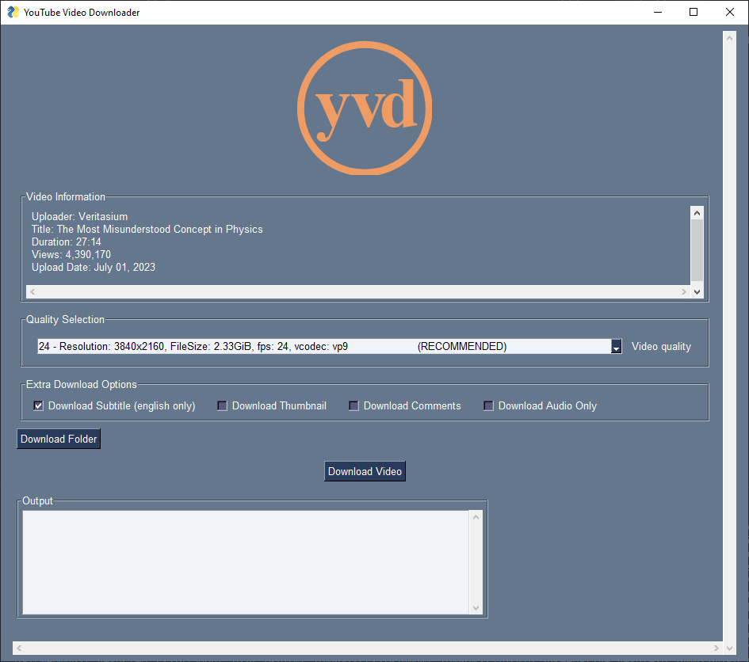

Slide 12
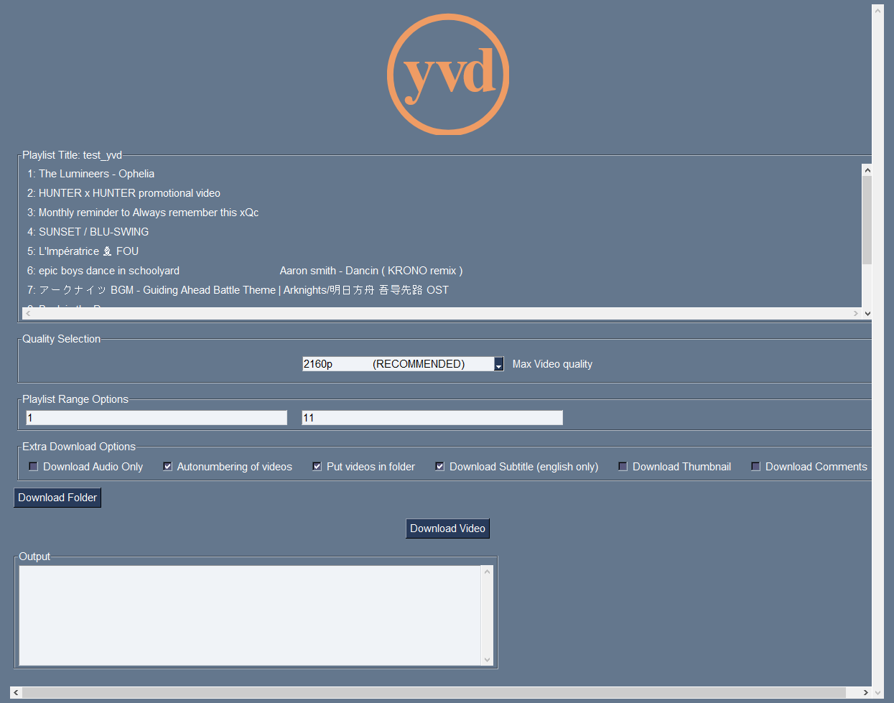

Slide 13
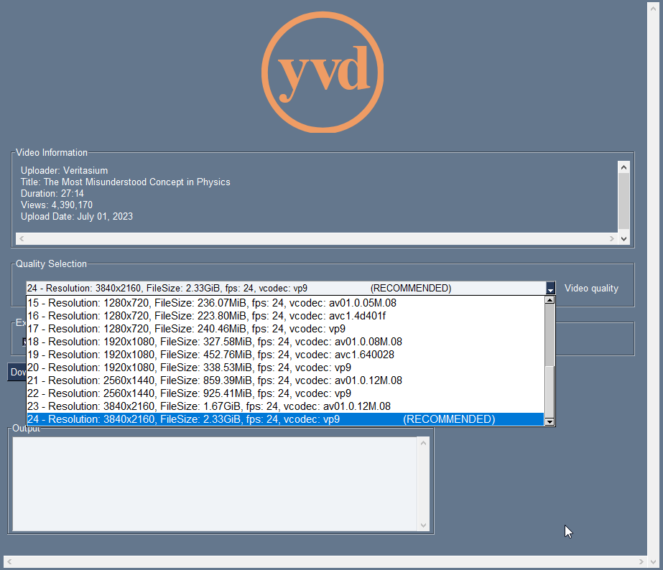

Slide 14
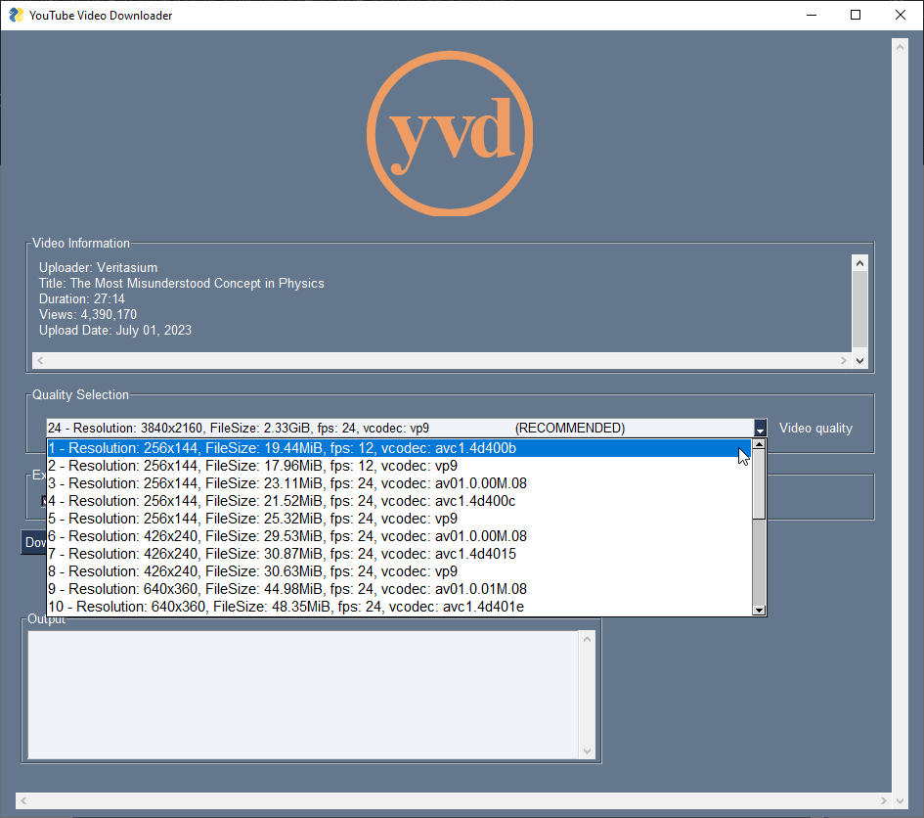

Slide 15
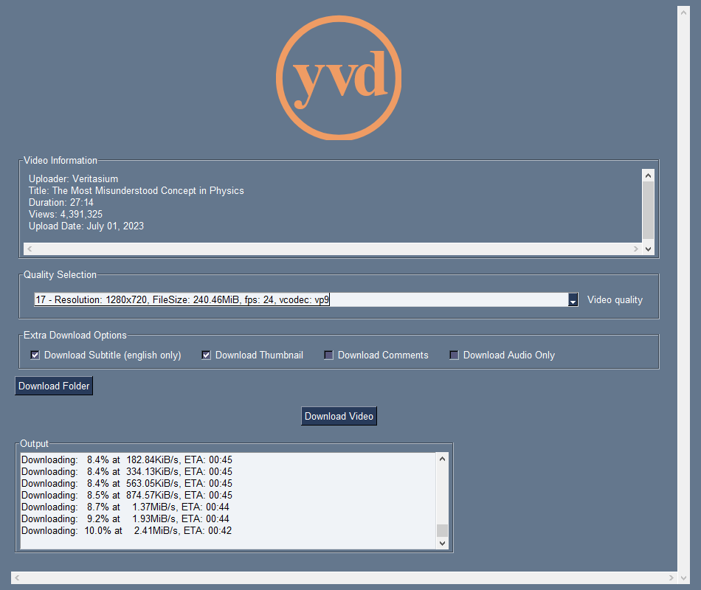

Slide 16
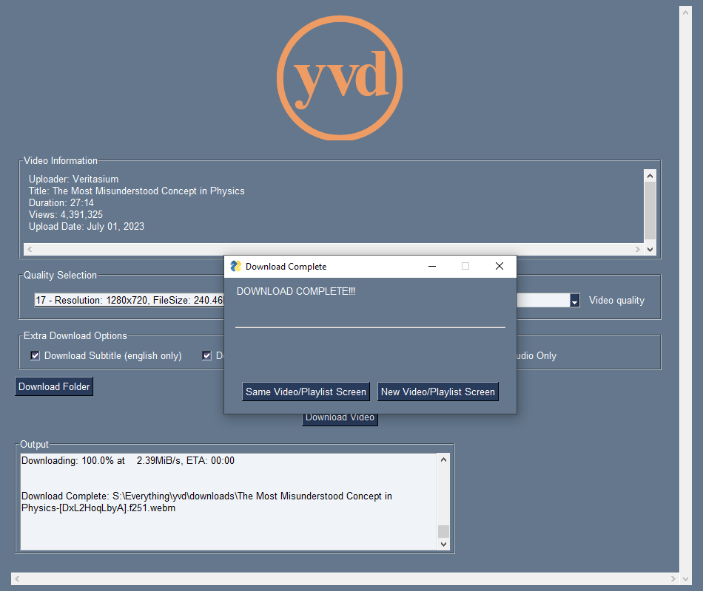

Slide 17
Technical Implementation
The user inputs a YouTube video or playlist URL in the initial screen GUI
The validate_youtube_url() function is called to check if the URL is valid
It uses the yt_dlp library to extract metadata from the URL
It checks if the domain is YouTube.com to determine if the URL is valid
If invalid, an error message is displayed in a popup
If valid, relevant info is extracted from the URL
Based on the info, the suitable video or playlist GUI screen is presented
The user selects options like quality, format, subtitles, folders, etc.
The folderr() function generates an output file template string
It accounts for playlist options like numbered files and folder structure

Slide 18
Technical Implementation cont.
When the user clicks "Download", the correct function is called
The functions set necessary yt_dlp options based on the user's choices
A progress_hook function is assigned to track download progress
The actual download starts with yt_dlp.YoutubeDL().download()
The progress hook continuously updates the GUI with:
- The percentage completed
- Current download speed
- Estimated time remaining
For playlists, each video is downloaded sequentially
The user can continue downloading new videos/playlists or restart

Slide 19
Testing and Validation
• The program was tested with a variety of YouTube URLs, including:
- Single video URLs
- Playlist URLs
- URLs with and without parameters
- Shortened YouTube URLs
• It was validated by:
- Downloading different video qualities and formats
- Downloading videos with and without subtitles
- Downloading audio only
- Downloading thumbnails and comments
- Bulk downloading an entire playlist

Slide 20
Testing and Validation cont.
• The error handling was tested by:
- Using invalid YouTube URLs
• The functionality for:
- Selecting a folder to download to
- Numbering playlist video filenames
- Putting playlist videos in separate folders
was thoroughly tested and validated
• Testing was performed on:
- Windows
- Linux

Slide 21
Testing and Validation cont.
• The user interface was tested for:
- Responsiveness and ability to handle long video titles
- Visibility of download progress
- Clear display of error messages
- Ability to continue downloading after completion
• Edge cases tested include:
- Very long playlist downloads
- High resolution video downloads
- Unicode characters in video titles

Slide 22
Testing and Validation cont.
• Feedback was collected from:
- Peers
- Potential users
• Issues uncovered during testing were addressed and the program was updated accordingly.

Slide 23
Future Improvements and Enhancements
Custom filename templates
Pausing/resuming downloads
Clean temporary junk files
Archive lists and entire channel downloading
Cloud upload
Selective playlist downloading
Encoding to multiple formats
Streaming directly
Multiple subtitle languages
More robust error handling

Slide 24
Conclusion
This application can download YouTube videos, playlists and even entire channels with many options.
It gives users control over format, quality and options like subtitles, audio and more.
The PySimpleGUI GUI and yt_dlp library handle the interfaces and technical aspects respectively.
Thorough testing ensured the program works reliably across platforms and scenarios.
With refinements, this YouTube downloader has potential as a robust solution at scale.

